Slide 1


DIGITAL ADVERTISEMENT CAMPAIGN ANALYSIS
This project focuses on analyzing digital advertisement campaigns.
The campaigns were run on four platforms: Instagram, Facebook, YouTube, and Google Ads.
The data includes over 100 campaigns conducted between January 2024 and March 2025.
The goal is to study campaign performance using key metrics such as cost, impressions, clicks, conversions, and revenue.

Slide 2
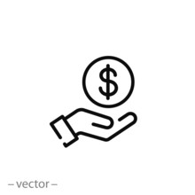

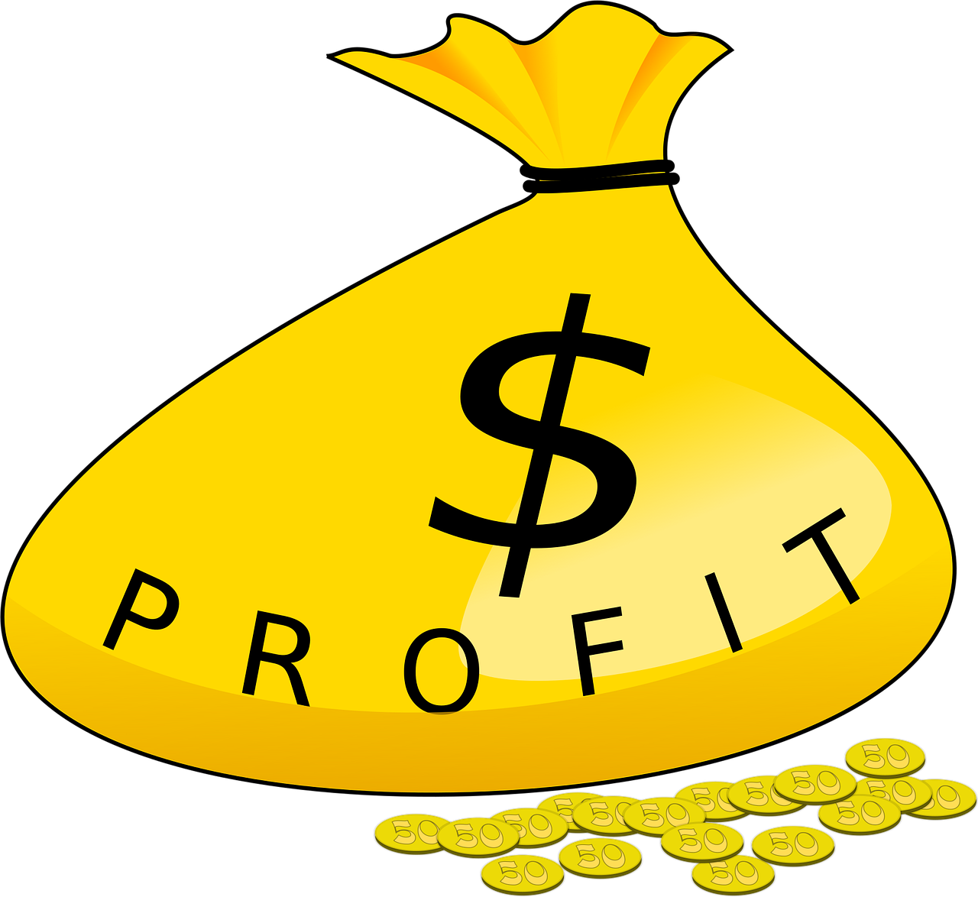



TOTAL
COST
We spent 53,91,500 on digital advertising across all platforms during the campaign period .
TOTAL
REVENUE
The campaign generated 1,46,30,000 in total revenue from product sales .
TOTAL
PROFIT
Net profit amounted to 92,38,500 after subtracting advertising costs from total revenue .
TOTAL
IMPRESSIONS
The ads were displayed 2,69,69,000 times to users across search engines and social media .
TOTAL
CLICKS
Out of all impressions, 14,26,500 users clicked on the ads to learn more and visit the website .
A total of 1,26,480 users completed a desired action such as making a purchase or signing up .
TOTAL
CONVERSIONS

Slide 3





April 2024 Ad Campaign Performance
Instagram was the most expensive platform but delivered the best returns.
Facebook had minimal investment but also yielded the least profit.
  In April, Instagram had the highest cost and profit, while Facebook had the lowest cost and profit.

Slide 4



May 2024 Ad Campaign Performance
Facebook had the highest cost and also generated the highest profit in May.
YouTube recorded the lowest cost and also the lowest profit during this month.
In May, Facebook had the highest cost and profit, while YouTube had the lowest cost and profit.

Slide 5

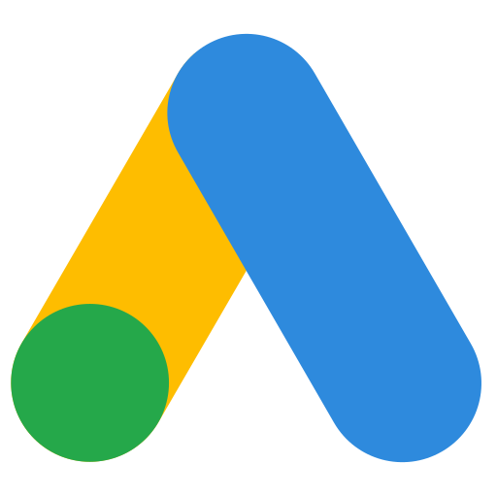
June 2024 Ad Campaign Performance
YouTube was the most expensive platform but delivered the best returns.
Google Ads had minimal investment but also yielded the least profit.
  In June, YouTube had the highest cost and profit, while Google Ads had the lowest cost and profit.

Slide 6
July 2024 Ad Campaign Performance
Google Ads had the highest cost and also generated the highest profit in July.
Instagram recorded the lowest cost and also the lowest profit during this month.
In July, Google Ads had the highest cost and profit, while Instagram had the lowest cost and profit.

Slide 7
August 2024 Ad Campaign Performance
Instagram was the most expensive platform but delivered the best returns.
Facebook had minimal investment but also yielded the least profit.
  In August, Instagram had the highest cost and profit, while Facebook had the lowest cost and profit.

Slide 8

September 2024 Ad Campaign Performance
Facebook had the highest cost and also generated the highest profit in September.
YouTube recorded the lowest cost and also the lowest profit during this month.
In September, Facebook had the highest cost and profit, while YouTube had the lowest cost and profit.

Slide 9

October 2024 Ad Campaign Performance
YouTube was the most expensive platform but delivered the best returns.
Google Ads had minimal investment but also yielded the least profit.
  In October, YouTube had the highest cost and profit, while Google Ads had the lowest cost and profit.

Slide 10

November 2024 Ad Campaign Performance
YouTube had the highest cost and also generated the highest profit in November.
Google Ads recorded the lowest cost and also the lowest profit during this month.
In November, YouTube had the highest cost and profit, while Google Ads had the lowest cost and profit.

Slide 11

December 2024 Ad Campaign Performance
YouTube was the most expensive platform but delivered the best returns.
Google Ads had minimal investment but also yielded the least profit.
  In December, YouTube had the highest cost and profit, while Google Ads had the lowest cost and profit.

Slide 12

January 2025 Ad Campaign Performance
YouTube had the highest cost and also generated the highest profit in January.
Google Ads recorded the lowest cost and also the lowest profit during this month.
In January, YouTube had the highest cost and profit, while Google Ads had the lowest cost and profit.

Slide 13
February 2025 Ad Campaign Performance
YouTube was the most expensive platform but delivered the best returns.
Google Ads had minimal investment but also yielded the least profit.
  In February, YouTube had the highest cost and profit, while Google Ads had the lowest cost and profit.

Slide 14

March 2025 Ad Campaign Performance
YouTube had the highest cost and also generated the highest profit in March.
Google Ads recorded the lowest cost and also the lowest profit during this month.
In March, YouTube had the highest cost and profit, while Google Ads had the lowest cost and profit.

Slide 15

Advertisement Cost and Profit by Platform
PLATFORM | COST | PROFIT
YouTube | 14,35,000 | 24,50,000
Facebook | 13,37,000 | 22,76,000
Instagram | 13,24,000 | 22,79,500
Google Ads | 12,95,500 | 22,33,000

Slide 16



Key Insights from Advertisement Data
YouTube has the highest cost and highest profit among all platforms.
Facebook’s cost is higher than Instagram, but its profit is lower.
Instagram shows better ROI compared to Facebook.
Google Ads has the lowest cost, but also the lowest profit.
YouTube appears to be the most effective platform in terms of profit generation.

